Slide 1
Lesson objective
09/02/22
Title: Negative integers
Aim:
Efficiently add and subtract negative numbers
Demonstrate partitioning strategies for addition
Plan:
Daily review: rounding
Negative integers practice
Partitioning strategies
Need a ruler and whiteboards

Slide 2
Daily review
What is the place value of 2 in these numbers?
210
32.34
102 350
10.2
45.002
Whiteboards
Round these numbers to the nearest TEN.
34 788
214
398
201

Slide 3
Review: negative numbers
Adding a negative number is the same as _________
Subtracting a negative number is the same as ________

Slide 4
Whiteboards
12 + -5 =
18 + - 9 =
-3 + -7 =
-10 + -5 =
7 - -8 =
12 - -4 =
34 - -12 =
-9 - -11
-11 - -14 =

Slide 5


Exercise books
Billy G. owns a plane and a submarine. His plane is flying 1200m above sea level and his submarine is 340m below sea level. How far below the airplane is the submarine?
If the submarine dives to 740m below sea level, what is the difference between its two positions?
$$8+\left(−3\right)=$$
$$12+\left(−5\right)=$$
$$\left(−7\right)+\left(−3\right)=$$
$$\left(−19\right)+\left(−10\right)$$
$$25+\left(−30\right)=$$
$$\left(−32\right)+12=$$
$$\left(−17\right)+\left(−17\right)=$$
5
7
-10
-29
-5
-20
-34
$$12 −−4=$$
$$25 −−5=$$
$$\left(−15\right)−5=$$
$$\left(−8\right)−17=$$
$$26 −−21=$$
$$\left(−34\right)−31=$$
$$\left(−21\right)−−21=$$
16
30
-20
-25
47
-65
0
= 1540m apart
= difference is 400m

Slide 6
What should you do when you can’t sleep?
BEFORE WE START
Look over all the questions and any time you “ - - ” (minus a negative number) turn it into a + (plus)
Use your notes to complete the worksheet
Finish the worksheet

Slide 7
Partitioning strategies
Partitioning is a mental strategy where you break up a number into parts.
Looks like:
456
250
1398

Slide 8
Whiteboards
Partition these numbers
430
568
12521

Slide 9
Partition and addition
Sometime partitioning a numbers during addition can help mental calculations.
Looks like:
341 + 236 =
300 + 40 + 1
+ 200 + 30 + 6
577

Slide 10
Whiteboards: you try
Partition the numbers, then add them together. Show your working out.
512 + 257 =
756 + 123 =
705 + 291 =

Slide 11
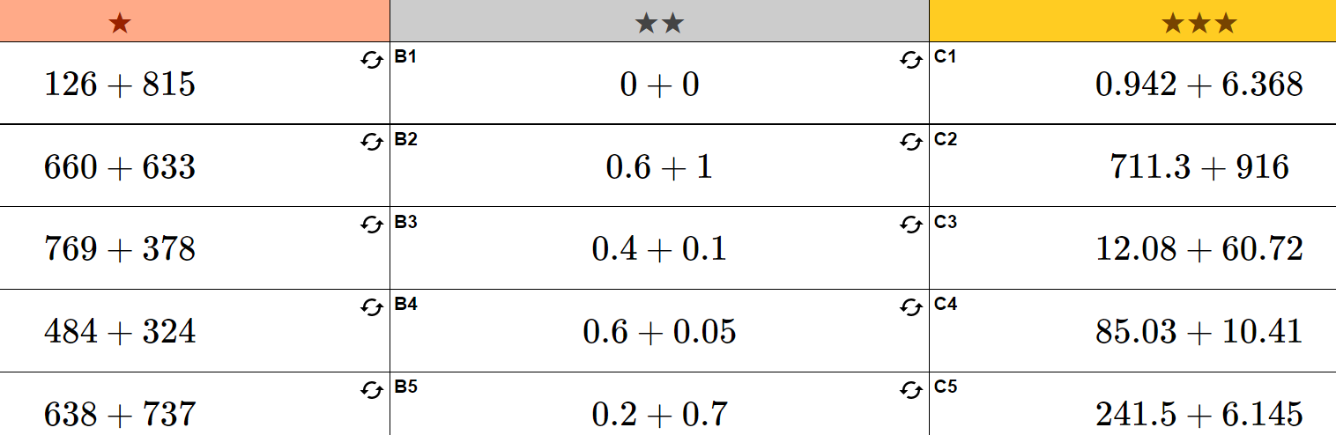
Exercise books

Slide 12
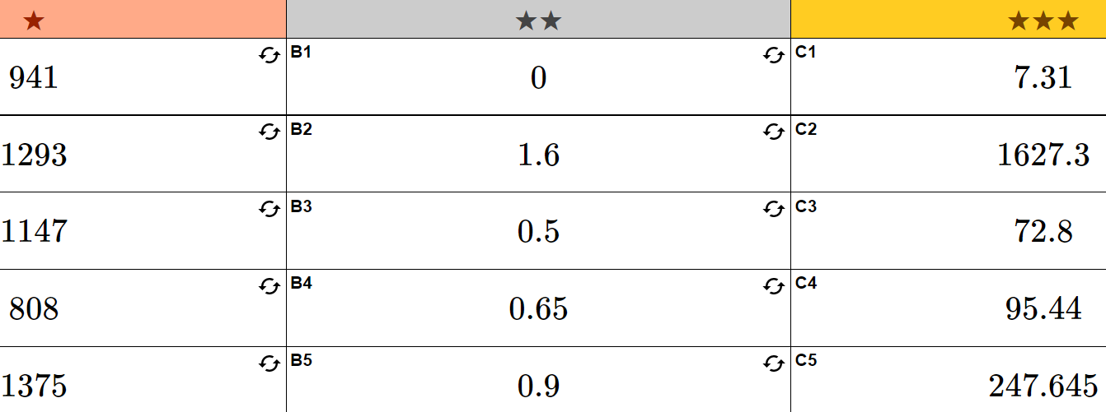
Answers

Slide 13


How did we do?
Aim:
I feel confident when using negative numbers
Demonstrate partitioning strategies for addition

